Slide 1
Chapter 24
Distributed DBMSs – Concepts and Design
Pearson Education © 2014

Slide 2

Chapter 24 - Objectives
Concepts.
Advantages and disadvantages of distributed databases.
Functions and architecture for a DDBMS.
Distributed database design.
Levels of transparency.
Comparison criteria for DDBMSs.
Pearson Education © 2014

Slide 3
Concepts
Distributed Database
  A logically interrelated collection of shared data (and a description of this data), physically distributed over a computer network.
Distributed DBMS
  Software system that permits the management of the distributed database and makes the distribution transparent to users.
Pearson Education © 2014

Slide 4
Concepts
Collection of logically-related shared data.
Data split into fragments.
Fragments may be replicated.
Fragments/replicas allocated to sites.
Sites linked by a communications network.
Data at each site is under control of a DBMS.
DBMSs handle local applications autonomously.
Each DBMS participates in at least one global application.
Pearson Education © 2014

Slide 5
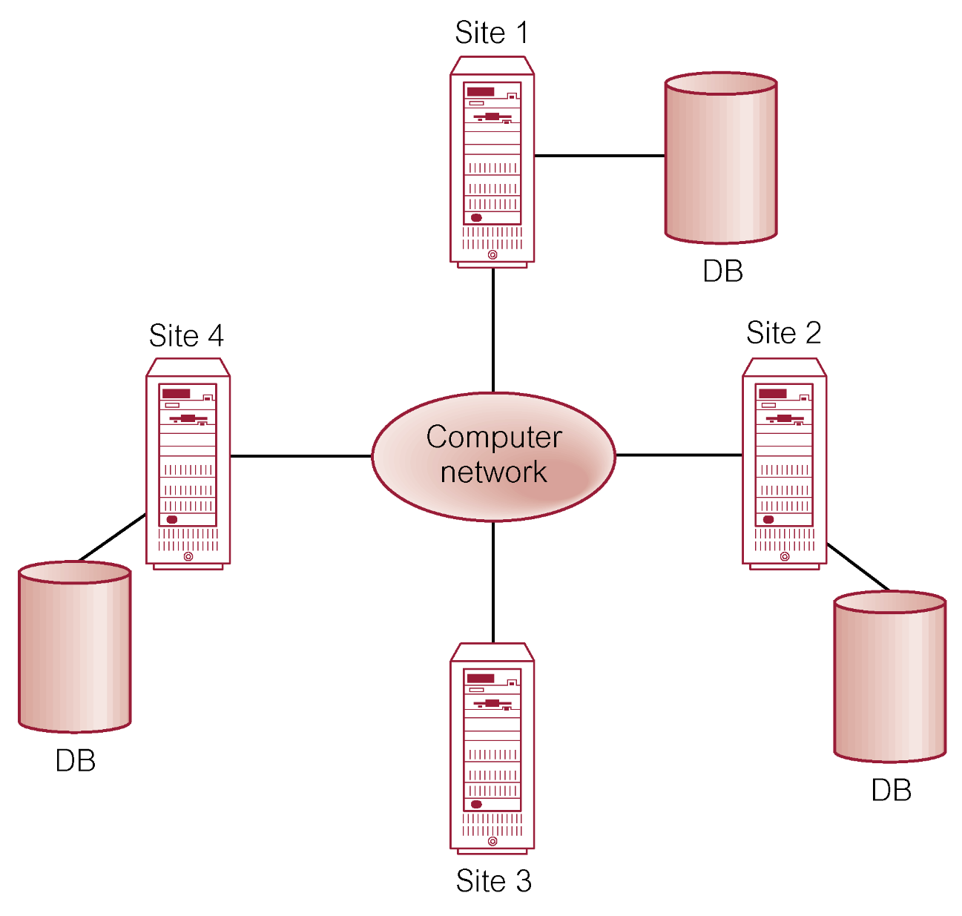
Distributed DBMS
Pearson Education © 2014

Slide 6
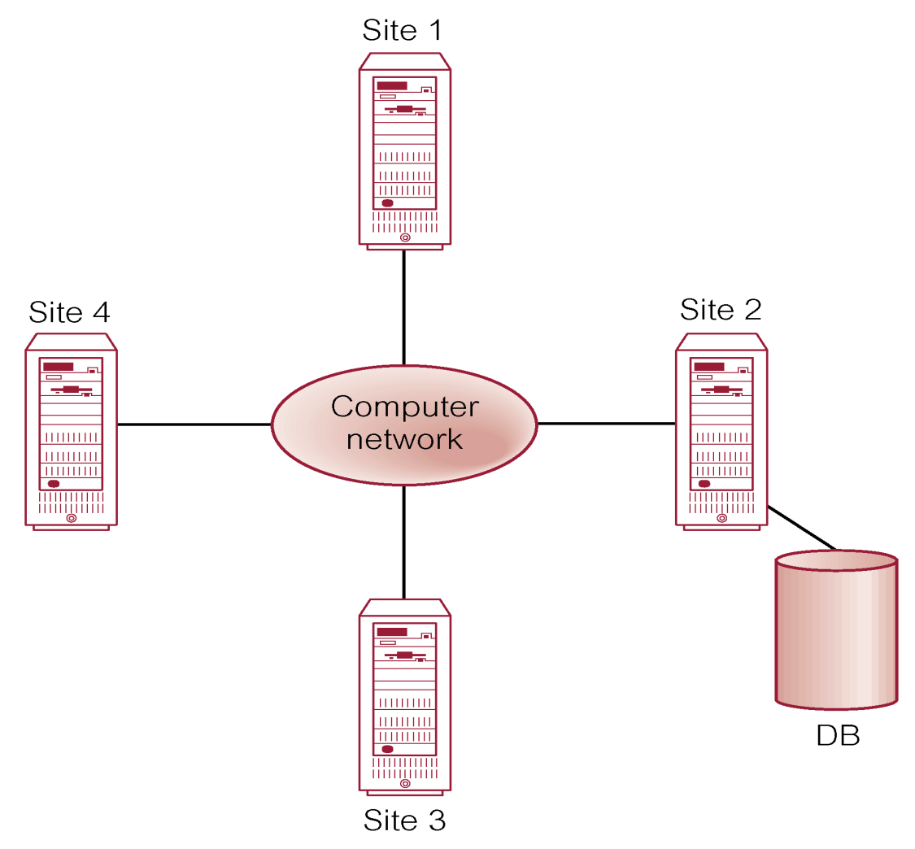
Distributed Processing
A centralized database that can be accessed over a computer network.
Pearson Education © 2014

Slide 7
Parallel DBMS
A DBMS running across multiple processors and disks designed to execute operations in parallel, whenever possible, to improve performance.
Based on premise that single processor systems can no longer meet requirements for cost-effective scalability, reliability, and performance.
Parallel DBMSs link multiple, smaller machines to achieve same throughput as single, larger machine, with greater scalability and reliability.
Pearson Education © 2014

Slide 8

Parallel DBMS
Main architectures for parallel DBMSs are:
  Shared memory,
  Shared disk,
  Shared nothing.
Pearson Education © 2014

Slide 9
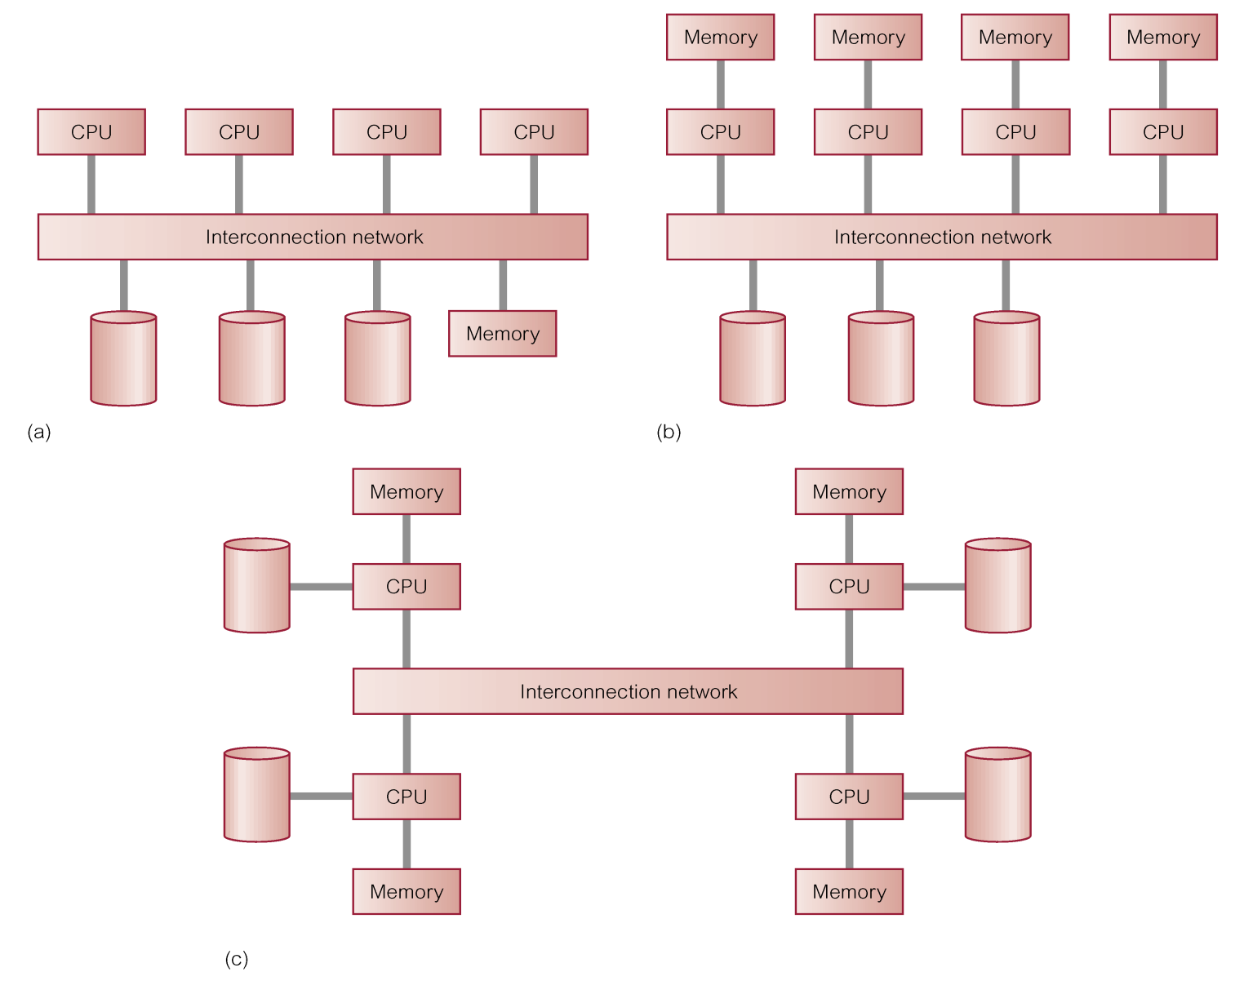
Parallel DBMS
shared memory
(e.g. one machine)
(b) shared disk
(cluster)
(c) shared nothing
(e.g. on the
internet)
Pearson Education © 2014

Slide 10
Advantages of DDBMSs
Reflects organizational structure
Improved shareability and local autonomy
Improved availability
Improved reliability
Improved performance
Economics ????
Modular growth
Pearson Education © 2014

Slide 11
Disadvantages of DDBMSs
Complexity
Cost
Security
Integrity control more difficult
Lack of standards
Lack of experience
Database design more complex
Pearson Education © 2014

Slide 12
Types of DDBMS
Homogeneous DDBMS
Heterogeneous DDBMS
Pearson Education © 2014

Slide 13
Homogeneous DDBMS
All sites use same DBMS product.
Much easier to design and manage.
Approach provides incremental growth and allows increased performance.
Pearson Education © 2014

Slide 14
Heterogeneous DDBMS
Sites may run different DBMS products, with possibly different underlying data models.
Occurs when sites have implemented their own databases and integration is considered later.
Translations required to allow for:
  Different hardware.
  Different DBMS products.
  Different hardware and different DBMS products.
Typical solution is to use gateways.
Pearson Education © 2014

Slide 15
Overview of Networking
Network - Interconnected collection of autonomous computers, capable of exchanging information.
Local Area Network (LAN) intended for connecting computers at same site.
Wide Area Network (WAN) used when computers or LANs need to be connected over long distances.
WAN relatively slow and less reliable than LANs. DDBMS using LAN provides much faster response time than one using WAN.
Pearson Education © 2014

Slide 16
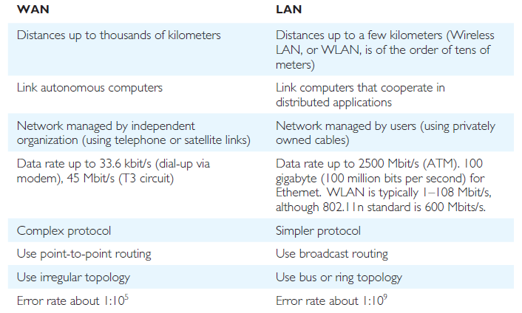
Overview of Networking - Optional
Pearson Education © 2014

Slide 17
Functions of a DDBMS
Expect DDBMS to have at least the functionality of a DBMS.
Also to have following functionality:
  Extended communication services.
  Extended Data Dictionary.
  Distributed query processing.
  Extended concurrency control.
  Extended recovery services.
Pearson Education © 2014

Slide 18
Distributed Database Design
Three key issues:
  Fragmentation,
  Allocation,
  Replication.
Pearson Education © 2014

Slide 19
Distributed Database Design
  Fragmentation
  Relation may be divided into a number of sub-relations, which are then distributed.
  Allocation
  Each fragment is stored at site with “optimal” distribution.
  Replication
  Copy of fragment may be maintained at several sites.
Pearson Education © 2014

Slide 20
Date’s 12 Rules for a DDBMS
0. Fundamental Principle
  To the user, a distributed system should look exactly like a nondistributed (centralized) system.
1. Local Autonomy
2. No Reliance on a Central Site
3. Continuous Operation
4. Location Independence
5. Fragmentation Independence
6. Replication Independence
Pearson Education © 2014

Slide 21
Date’s 12 Rules for a DDBMS
7. Distributed Query Processing
8. Distributed Transaction Processing
9. Hardware Independence
10. Operating System Independence
11. Network Independence
12. Database Independence
Last four rules are ideals.
Pearson Education © 2014

